Slide 1
George street Early reading workshop
“Regular readers sleep better, have lower stress levels, higher self-esteem, and lower rates of depression than non-readers.” readingpartners.org
23rd September 2026

Slide 2

Why is reading important?
It ignites creativity, sparks curiosity, and stimulates the imagination in young children. Often, this leads to role-play as children grow which helps to develop other skills such as empathy, problem-solving, and morality.

Slide 3
Today WE WILL COVER…
Why we do what we do
Read Write Inc – phonics including key terminology used with the children
Reading lessons and reading books

Slide 4
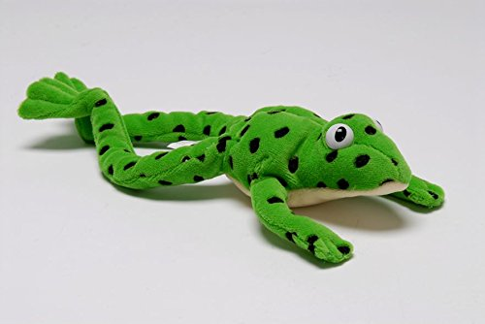
Read WRITE INC…
We have adopted the RWI programme because it allows us to teach phonics in a systematic way.
The programme is carefully planned so that children progress from learning the individual sounds of each letter, to blending the letters to pronounce words, working through to more complex sounds.
By using RWI we ensure that the children are taught phonics systematically and consistently.
DECODING SOUNDING OUT FRED TALK BLENDING PHONEMES GRAPHEMES DIAGRAPHS SPECIAL FRIENDS SPLIT DIAGRAPHS SEGMENTING FRED IN THE HEAD

Slide 5
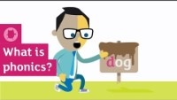
What is phonics?

Slide 6

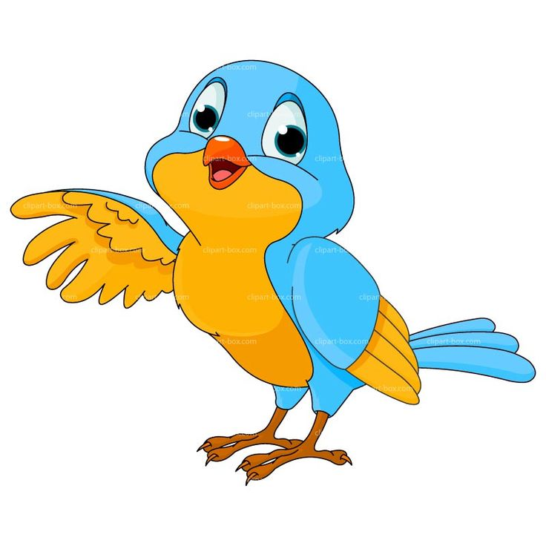

Nursery – RWi
Building children’s listening skills in preparation for Set 1 sounds.
Environmental sounds to build children’s listening skills of ‘tuning in’ to sounds, and recognising sounds that they can hear.
Fred Talk games to practice Fred Talk and blending sounds together –
Fred I Spy, Fred Says, Animal Fred.
Start to learn the Set 1 sounds in the Summer Term focusing on the corresponding picture.

Slide 7
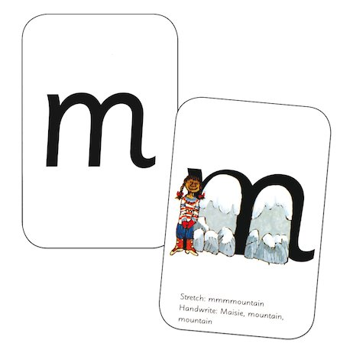
Reception – RWi
Teaching the Set 1 sounds
m a s d t i n p g o c k u b f e l h r j v y w z x
Say the sound – stretching mmmmm, stretching mmm mountain
Read the sound
Reviewing the sounds – practicing previously learned sounds
Air-Writing the sounds
Fred Talk – orally blending words in sounds, using our new learned sound.
Wherever your child may have previously attended will have covered the foundations of phonics learning in some way. This may have been through a different scheme but the fundamentals remain the same. These are what we then build upon in Reception.

Slide 8
Reception – RWi
Fred games to explore ‘Fred talk’ throughout the day
Letter formation phrases – bringing the new sound sheets home each week to practise (These can stay at home for children to refer to)
Teaching the strategy of reading
      Learning to blend
      Sounding out and blending green words
      Phonically decodable texts building fluency (Ditties and RWI storybooks)

Slide 9
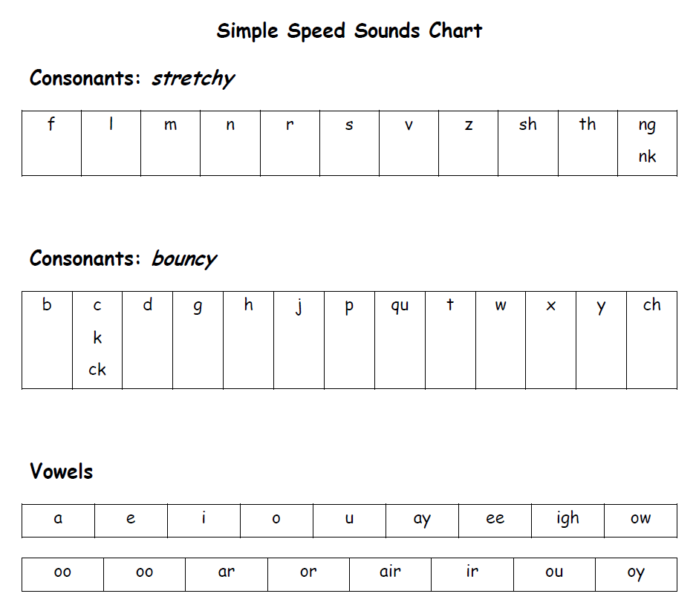
Reception – RWi
Accurate sound pronunciation
Fundamental for the development of blending
Pure sounds – the unwanted ‘schwa’
Special friends – more than one letter making a sound (sh, ch, qu, igh)
Sound chart split into the types of sound – taught in a different, specific order (m, a, s, d, t are the first 5 sounds to support children to then blend words with these sounds in.)
https://www.youtube.com/watch?v=KUbrJPAt65g – How to say the sounds accurately

Slide 10
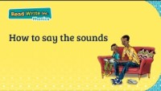
Accurate Sounds

Slide 11
Reception – RWi
Fred talk – initial sounds (b-b-ball), oral blending (h-a-t hat)
Fred fingers – pinching to spell, supported and modelled (“Hold up 3, pinch the sounds for dog, d-o-g) then moving onto asking children to identify how many sounds in a word to build independence with spelling.
Teaching the structure of a simple sentence including left to right, a capital letter, full stop and finger spaces for both reading and writing

Slide 12
Reading
Daily story time – exploring core books, linked books and authors.
Building children’s awareness of story structure – beginning, middle and end.
Reading from left to right, and from top to bottom, and page sequencing.
Learning the names of different parts of a book, e.g. front cover, author etc.

Slide 13

Reading
Core books
Developing a love of reading and enjoying stories.
Becoming familiar with our core books and building the ability to retell them to others.
Engaging in stories using repetitive phrases, such as “we’re going on a bear hunt, we’re going to catch a big one…”

Slide 14
Reception – Reading
Your child will have the following:
Reading book
Wordless books to begin with – explore prediction, inference and building story vocabulary
Sound blending books
Matched to their phonic ability (90% success)
Include decodable words and red words
Begin to build fluency and comprehension skills
Eventually will be sent home the book they have read in their reading sessions that week and an additional link text
We would expect you to read with your child at least 4 times a week and to sign their reading record.

Slide 15

How can you support at home?
https://www.ruthmiskin.com/parentsandcarers/ - Advice for parents including handwriting phrases and Fred talk games.
https://www.youtube.com/channel/UCo7fbLgY2oA_cFCIg9GdxtQ - Ruth Miskin YouTube Channel

Slide 16
Reception – supporting reading at home
Supporting Comprehension
    Children to practise demonstrating an understanding of what has been read to them
    Children to practise anticipating key events in stories.
Supporting Word Reading
    Children to practise reading aloud simple sentences and books, including decodable words and red words.
    Children to re-read books to build up their confidence in word reading, their fluency and their understanding and enjoyment.

Slide 17
Reception – Supporting reading at home
Reading is not just listening to your child read, it is also the valuable conversations about what is happening in the book, talking about; how characters are feeling, characters actions, making predictions about what might happen next and why.
Decoding, comprehension, predicting and reasoning are all skills that will make your child a better and more confident reader! ☺

Slide 18
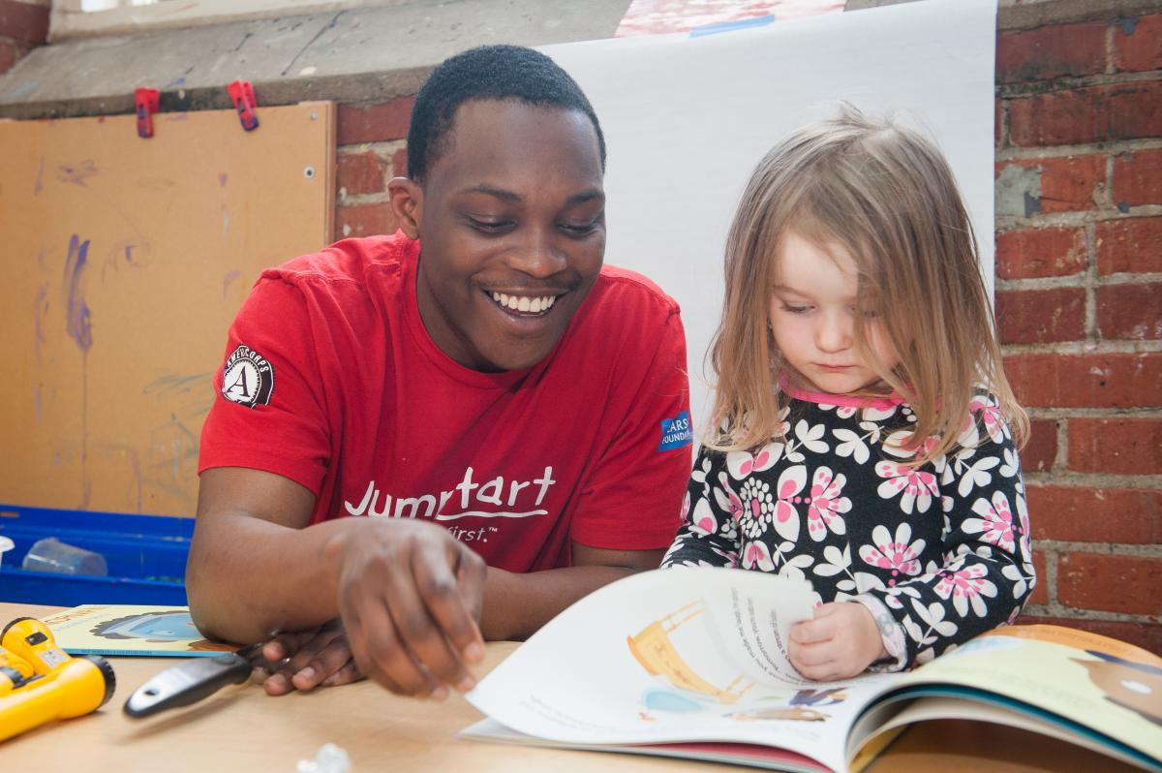
Every FRIDAY after OCTOBER half term…
Come and read with your child(ren)
8.45-9.00am

Slide 19
TAKE AWAY THREE THINGS…
PRACTISE PHONICS SOUNDS (not letter names)
READ TO YOUR CHILD
READ WITH YOUR CHILD

Slide 20
Please ask questions

