Slide 1
Year Six – meet the teacher
Miss Smyth
Mrs Shaw

Slide 2
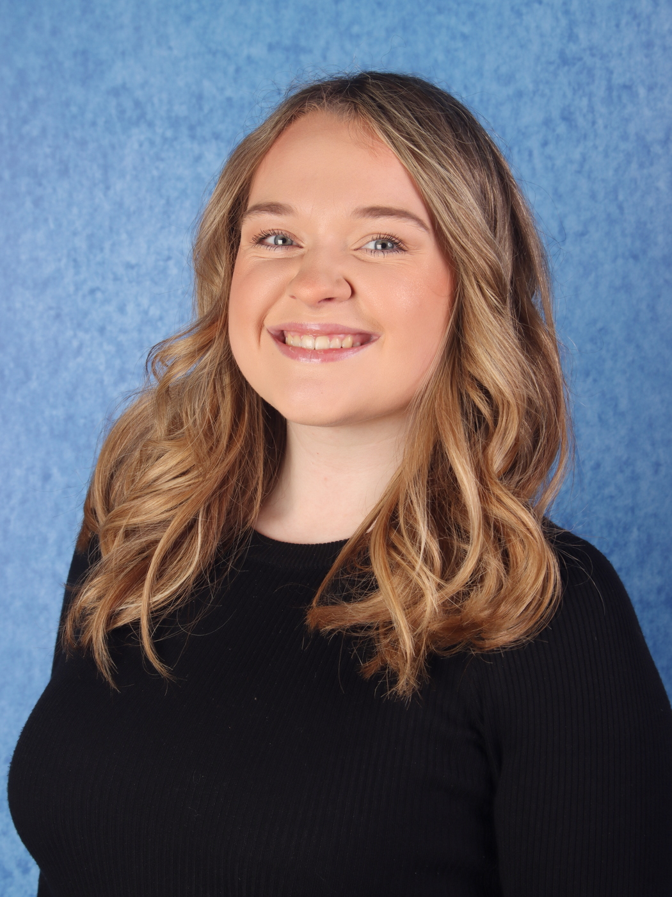
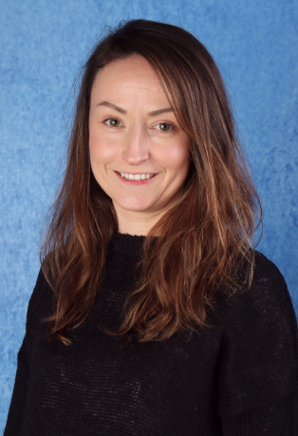
Year 6 staff:
Miss Smyth
Mrs Shaw

Slide 3

Reading:
Your child should be reading at home 4 times a week. This can be independently however, reading aloud to an adult is always encouraged.
After reading, your child should write a short summary of what they have read in their reading record. They can do this themselves or dictate to an adult to write for them. This does not have to be long or wordy.
Accelerated Reader - once they have finished their book, they will take a quiz and then choose a new book based on the score they got.
Children choose their own books with guidance from an adult.
Reading records will be checked daily in school.

Slide 4
Homework:
Homework will be set on a Friday and due in on the following Friday.
This will be Maths, Grammar and Reading
If children need help, they will be expected to ask on a Monday and homework should have been attempted before asking for help.
Homework will be completed in CGP books.

Slide 5
Homework:
Homework will be set on a Friday and due in on the following Friday.
This will be Maths, Grammar and Reading
If children need help, they will be expected to ask on a Monday and homework should have been attempted before asking for help.
Homework will be completed in CGP books. Please ensure these are in school daily.

Slide 6
Writing:
We are continuing to build upon the children’s learning that has happened across the whole of KS2.
Throughout this term, we will be continuing to use high quality, exciting texts and films to inspire fiction and non-fiction writing. We are currently using Arthur Spiderwick’s Field Guide to the Fantastical World Around You as a stimulus for our writing.
We are currently focusing on:
• Modal verbs
• Clauses (relative and subordinate)
• Up-levelling vocabulary for effect
• More complex punctuation such as semi colons and parenthesis.
• Extending sentences by varying the length and openers.

Slide 7
Maths:
The children have already covered place value, the four operations, fractions.
We are currently learning about algebra.
As we move through spring term, we will be covering: area and perimeter, fractions, decimals and percentages.
Throughout the week, daily fluency sessions will take place, which will recap and secure previous learning. Our daily fluency sessions will have a reasoning focus now that children have secured their arithmetic skills.

Slide 8
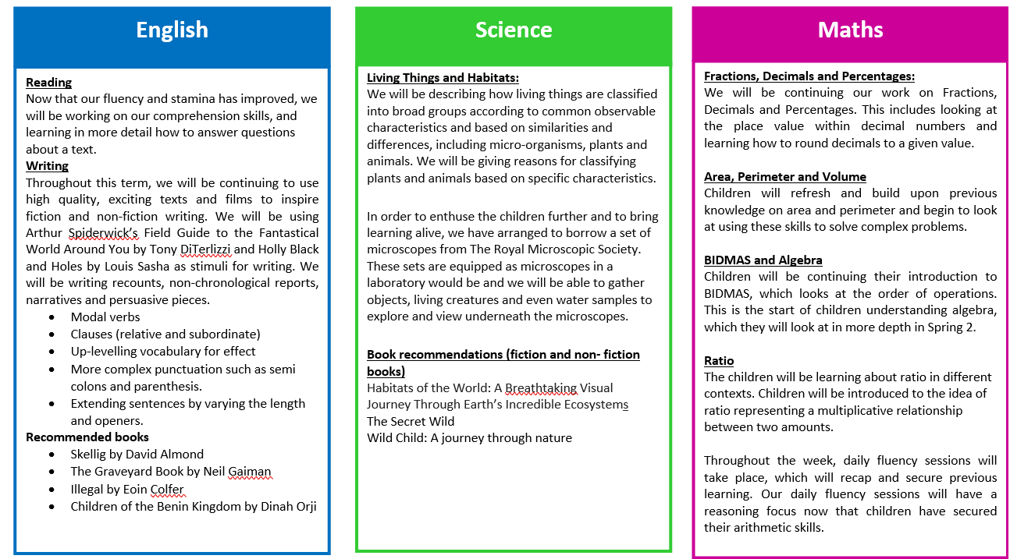

Slide 9
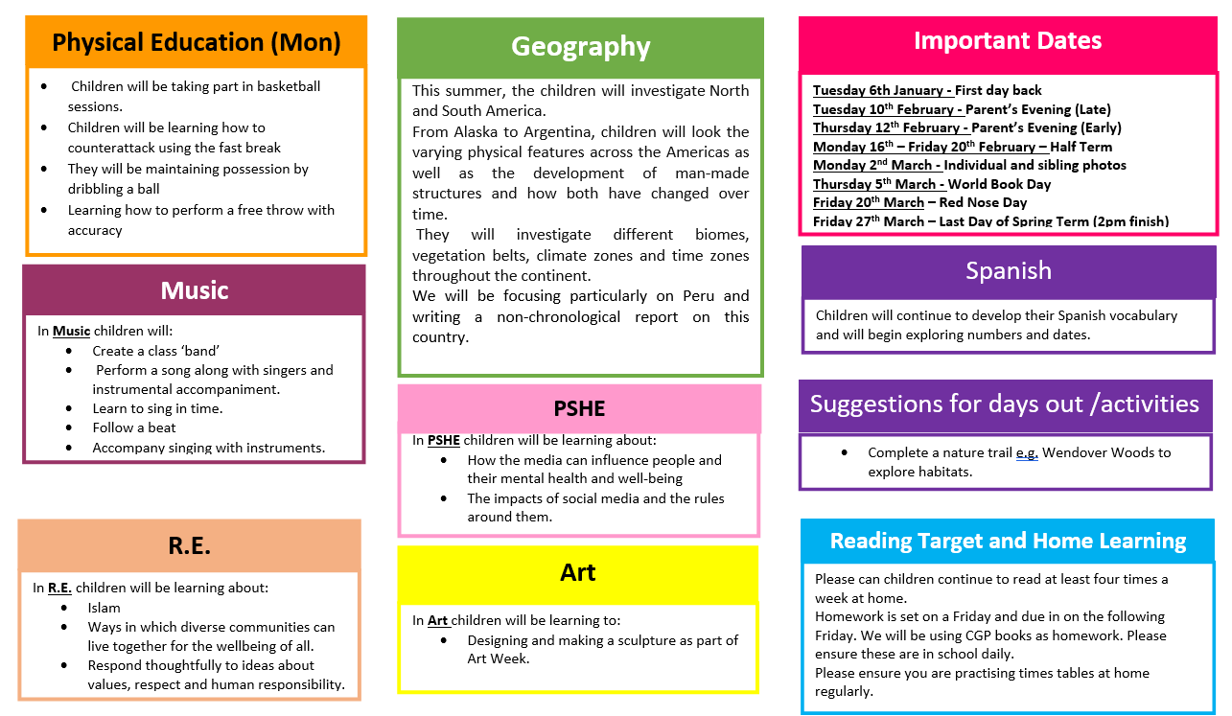

Slide 10
SATS:
In May, all children will participate in the end of KS2 compulsory tests.
Children will sit tests in Maths, Reading and SPaG (spelling, punctuation and grammar).
Their writing will be assessed throughout the course of the year.
Some children may be invited attend booster breakfast clubs.

Slide 11
Independence:
A big part of Year 6 is ensuring that children gain their independence so that they can be secondary school ready by the time they leave us.
This can be done by supporting your child to remember to bring what they need each day e.g. reading book, homework.
Remembering to bring in PE kits, football kits etc. so as not to ask parents to drop these in the middle of the day as this won’t happen at secondary school. It is best to build a good habit of this now.
Developing good personal hygiene and understanding changes that happen in the body so that children remember to shower daily, wear deodorant, brush teeth etc. so that they are ready for the day and follow a morning or evening routine.

Slide 12
School trips:
Hazard Alley Safety Centre
-> I am in the process of booking this. A letter will be sent out shortly.
PGL Liddington - 28th June - 1st July

Slide 13
Any Questions?

