Slide 1
Year 6 SATs information evening
Wednesday 4th March 2026

Slide 2
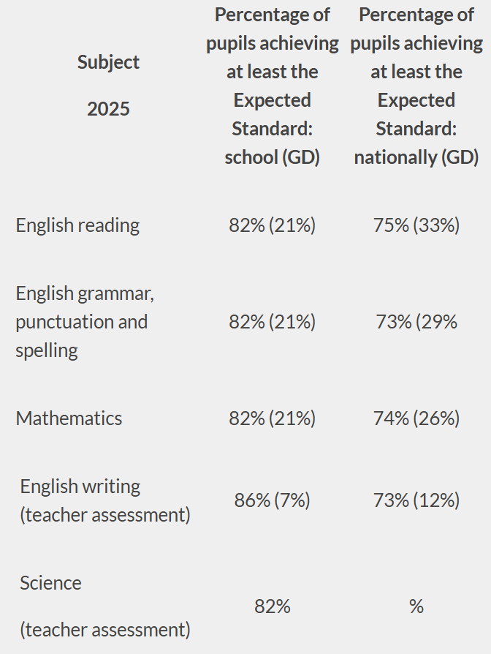
LAST Year’s outcomes

Slide 3
Why do children sit sats tests?
SATs are currently compulsory for all children in Year 6. Ultimately, they are used to measure the individual child’s attainment and progress in their time at primary school
It is very much for the child. It might sound hard to believe, but by the time they sit the tests, most children want to do them! They are so eager to try their best and show off all that they have learnt in their time here.
They are also very important for measuring the effectiveness of a school – they are one way of measuring a whole cohort’s progress to see how far they have brought the children in their learning. School data is then compared to county and national data too.
SATs can help parents gauge the progress that their child is making academically.
Secondary schools look at Year 6 SATs results, along with Year 7 CAT exams as part of the decision process when grouping students into sets or streams. GCSE trajectories can be based on end of KS2 data.

Slide 4
Preparation and support
The SATs test skills and the knowledge gained not only from Year 6, but throughout the entirety of primary school. Less than 50% of the content on the SATs papers come from units studied in Year 6, with the remaining content coming from their Year 5, 4 and 3 learning.
By revising and consolidating the curriculum in Year 6 – we can make sure gaps are filled and really secure their knowledge, not just for SATs, but for their secondary education too.
We regularly re-visit key number practise and skills.
SATs style homework is set weekly. Hopefully you have all now seen the CGP revision books that have come home. This exposes them to the style of questions they will have in SATs papers.
Practice tests - All practice tests allow us to identify gaps in their learning which inform our teaching, booster and intervention groups.
The Mock SATs week give children the opportunity to experience proper exam conditions and know how the week will run. By the time the real SATs come, children will know what to expect and will hopefully feel calm.

Slide 5
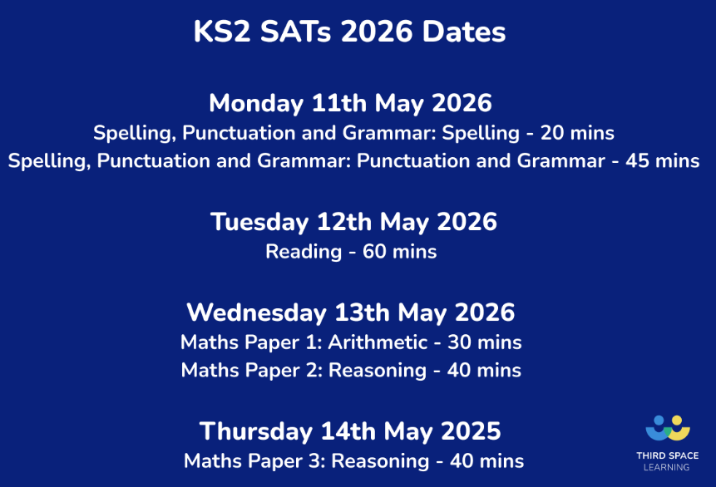
SATs week
In SATs week, all children will be invited to come in to school from 8am for breakfast, which is provided by the school.
These are NOT booster sessions and children will be offered breakfast and time to catch up with their friends in a relaxed environment before the tests start.
This is optional however, children who have attended these in the past have found that they prepare them well for the day ahead.
If your child is unwell on the morning of an exam, please call the school as soon as possible.

Slide 6
Spelling, punctuation and grammar (SPAg)
Comprised of 2 tests – combined score
Test 1 (45 minutes) measures their punctuation, spelling and grammar skills: terminology, word class, sentence types and structures (50 marks)
Test 2 measures their ability to spell words using a variety of rules plus the ability to remember key exception words (20 marks)

Slide 7
Reading
1 hour to complete the test
3 texts, usually a range of fiction and non-fiction and occasionally a poetry text.
A set of questions (usually around 12) about each text
Not a memory test – the children can refer to the questions and text as much as they want.
Focus on understanding language style and vocabulary, retrieval of information and their comprehension through inference/deduction style questions.
Scored out of 50 – 1, 2 and 3 mark questions.

Slide 8
Maths
Comprised of 3 tests
Test 1 (30 minutes) Arithmetic
Not in context and a focus on number, fraction and percentages.
Encourage the children to use efficient methods
Test 2 and 3 (each 40 minutes) - Reasoning
Questions are in context or require a deeper level of understanding than just procedural mathematics. Number geometry, coordinates, fractions, decimals and percentages, angles, algebra are covered.

Slide 9
Results
The Test
A raw score (number of correct answers)
Scaled score
Once all children’s results are in nationally, their raw score is converted into a scaled score.
What’s reported?
Your child’s SATs raw score, scaled score, school and national average scaled score and teacher assessment for science and writing.

Slide 10
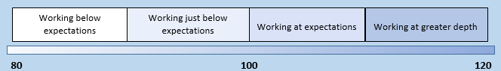
Scaled score
Child C
Raw score 42/50
Standardised score of 114
110 or over is classed as
‘Greater Depth’
Child A
Raw score 17/50
Standardised score of 93
Has not yet met the expected standard
Child B
Raw score 26/50
Standardised score of 100
Met the expected standard
Meeting the expected standard indicates that the child is in a good academic position to access the KS3 curriculum as their KS2 curriculum knowledge and understanding is at a good standard.
Of course, some children will not meet the expected standard so we will endeavour to get them as close to this as possible as we will focus on their progress.
Despite the SATs being in May, we still have two more months to prepare children for secondary school.

Slide 11
Reporting to parents
The school will be sent the results in July.
We will then be able to inform children/parents of their results.
This will be done on the end of year reports as either; working towards the expected standard, working at the expected standard or working above the expected standard.
If your child does not meet the expected standard, we can give details of their score to explain how far away they were.

Slide 12
Writing and science
As well as the SATs test results, each child is given a teacher assessment in writing and science, which shows the level that they are working at in school each day.
For Science only, ‘has not yet met expected standard’ or ‘working at the expected standard’ is reported.
These will also be reported to parents via the end of year school reports.

Slide 13
Any questions?
We want these exams to be as relaxed and as stress-free as possible!
Emphasis will be on effort and progress rather than attainment ☺

