Slide 1
Year 2 25/26
Adults –Miss Darvill, Mrs Phillips
Monday – Mrs Hammond
Tuesday – Miss K

Slide 2
Class agreements
Reading at home at least 4 times per week.
PE kit in school every Wednesday. Children should bring trainers, their house colour top and black shorts.
Home work will be set on a Friday and is expected to be completed by the following Thursday. Homework is uploaded onto the google classroom, the code is: 3beydn22

Slide 3
Reminders…
Children receive Dojo points as rewards in the classroom, these are counted as house points and go towards their house teams.
Reading morning will take place on a Friday morning in the classroom, we will be stopping at 8:55 to allow time to tidy up, take the register and lunch options before celebration assembly starts.
Please ensure uniform and PE kits are named.

Slide 4
Maths – Place value
What could you do at home to support your child’s learning.
Play counting games. Board games often show ordered numbers on tracks or grids.
Break down numbers – what makes a number.
For example, 2 and 3 make up 5, and 20 and 30 make up 50, 4 tens and 3 ones makes 43.
Have counting races.
Counting in 2's, 5’s, and 10’s.

Slide 5

English – Persuasive letter
The Great Kapok Tree
Whole school book – building a sense of community and school cohesion
A way to encourage all children to get back into learning with a variety of tasks.
We are exploring emotive language, persuasive writing and using adjectives to describe the setting.

Slide 6
Homework
Homework will be set on a Friday and due in on the following Thursday.
This will be Maths, English and daily reading.
This will be set on Google Classroom - 3beydn22

Slide 7
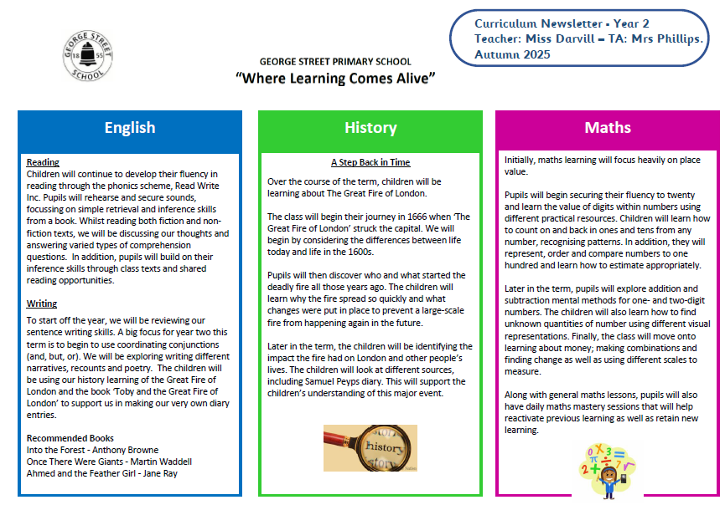

Slide 8
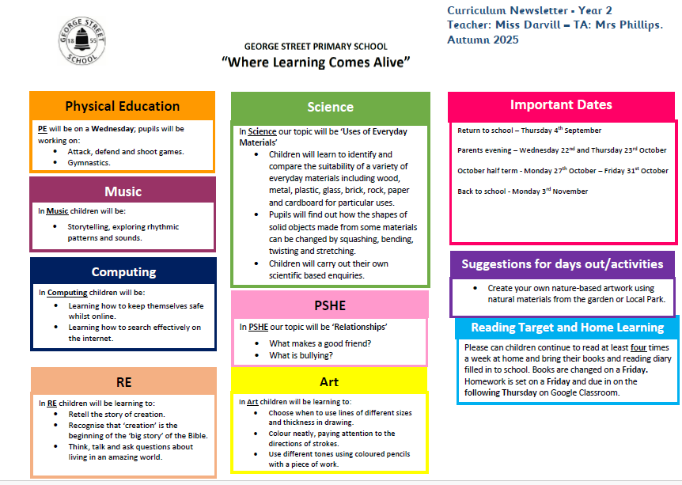

Slide 9
Any other questions?

