Slide 1

Year 1&2 reading and
phonics workshop

Slide 2
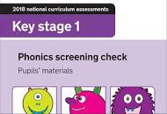
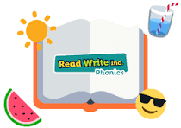
Purpose of this meeting:
To explain the process of phonics teaching at George Street School.
To explain how the Year 1 Phonics Screening check works that will be held in June 2026.
To improve everyone’s confidence in supporting the children in all of our care with their phonics learning by sharing resources and activities we use in school
To recap strategies that were introduced in Reception which will help your child with their reading.

Slide 3
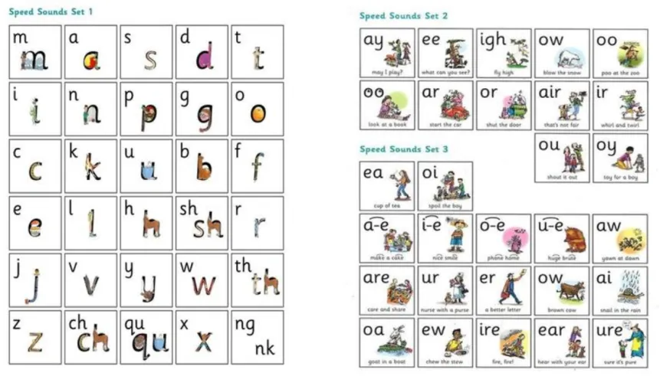
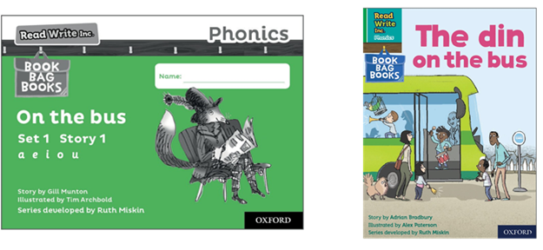
So how does reading and phonics at George Street look?
Read Write Inc. (RWI)
Daily speed sounds session followed by a reading session. (every day except Friday)
Reading across all curriculum
Reading on a Friday in school
Reading at home.

Slide 4
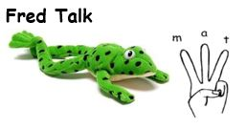
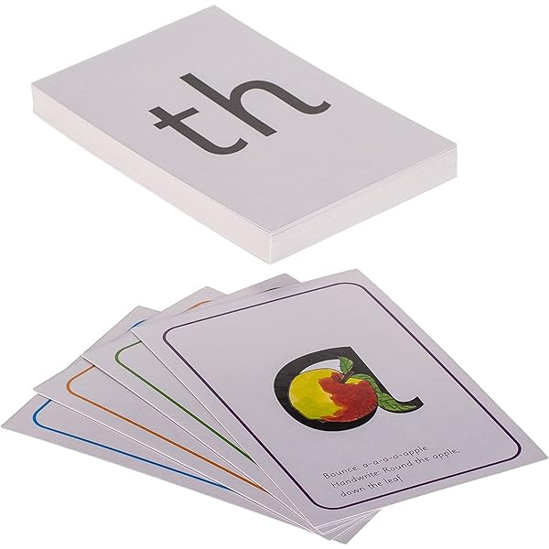
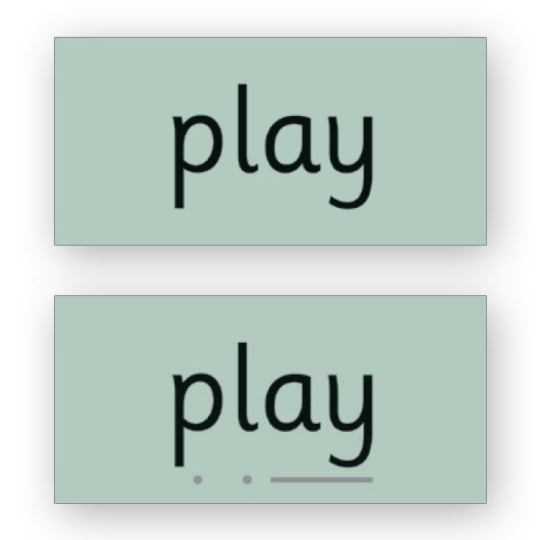
What does a daily phonics session look like?
Introduce the sound – play games.
Sound in the pack.
Show a word with sound incorporated.
Teacher model ‘Fred talk’
Ask the children to say the word.
Repeat 3-5 with four or five other words with that sound.
Review words – Special friends, Fred Talk, Say the word/Fred in your head/ Speedy reading.
Alien words.
Spell the words:
- Each sound in each word on fingers pinched.
- children write the word
- Check the word

Slide 5
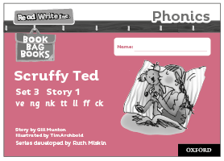


What does a daily reading session look like?
Sessions all different over three or four days depending on the colour of book your child is reading.
Generally:
Share the book
Practise the words used in the story on cards first. Story green words, speedy green words and red words.
Children read the sounds, words and story in pairs to each other turn taking using a lolly stick. One points to the word and the other reads. Then they swap.

Slide 6
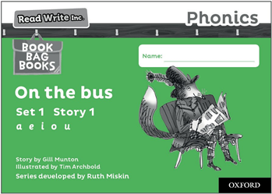
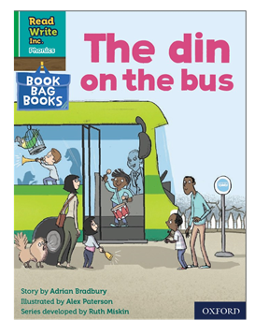
What does reading look like between school and home?
We will send home two books.
The first book we will have read for several days beforehand.
Your children should be able to confidently read this book by the time it comes home, they are developing their fluency and story teller voice now with this book.
The second book uses the same sounds and words that the first
book uses and supports the learning from the first book in a different context.
You may find your children are reading fluently but please check they are understanding what is written. Use the questions at the back of the book to help with this.

Slide 7

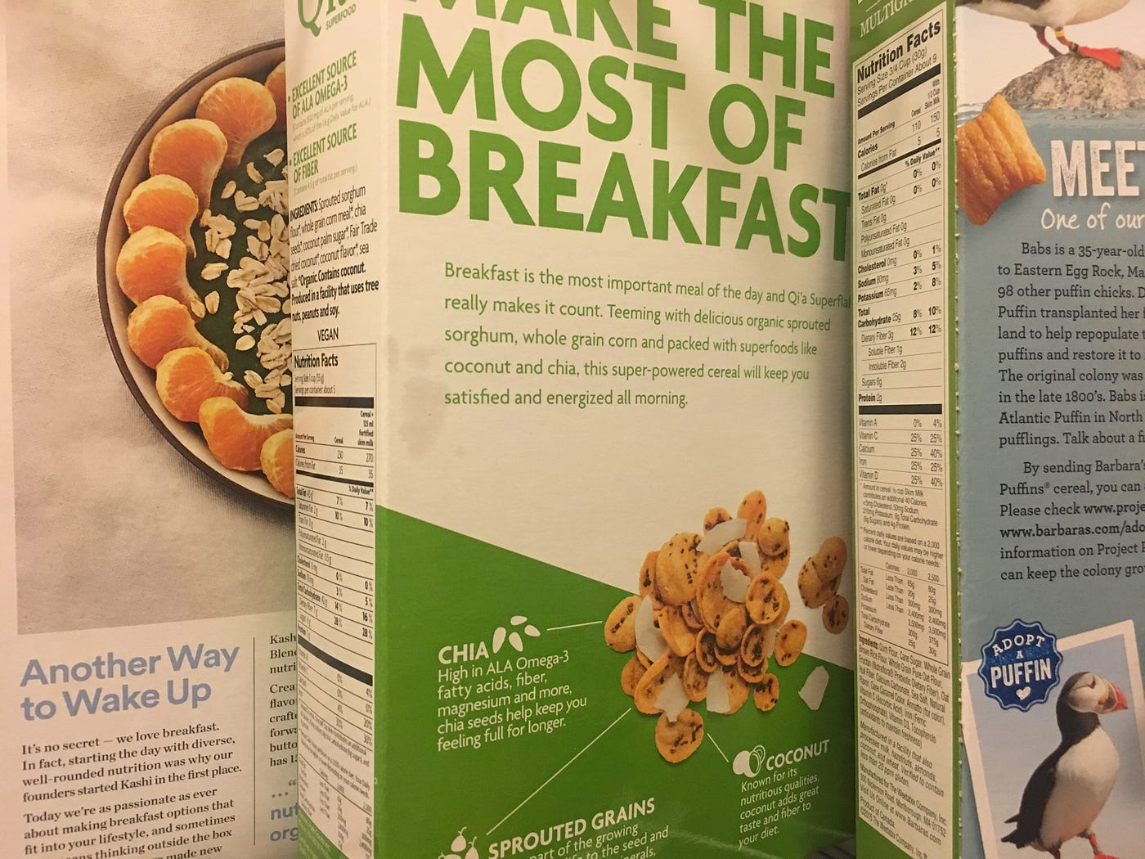
What does reading look like between school and home?
Read everything to your child at home, the back of the cereal packet, street signs, put the subtitles on whilst watching TV,
newspapers, children’s magazines and recipes!
Do read to your child ☺
Read books that are beyond your child’s capability.
This develops a broad vocabulary, concentration and it is a great bonding time for you all!

Slide 8
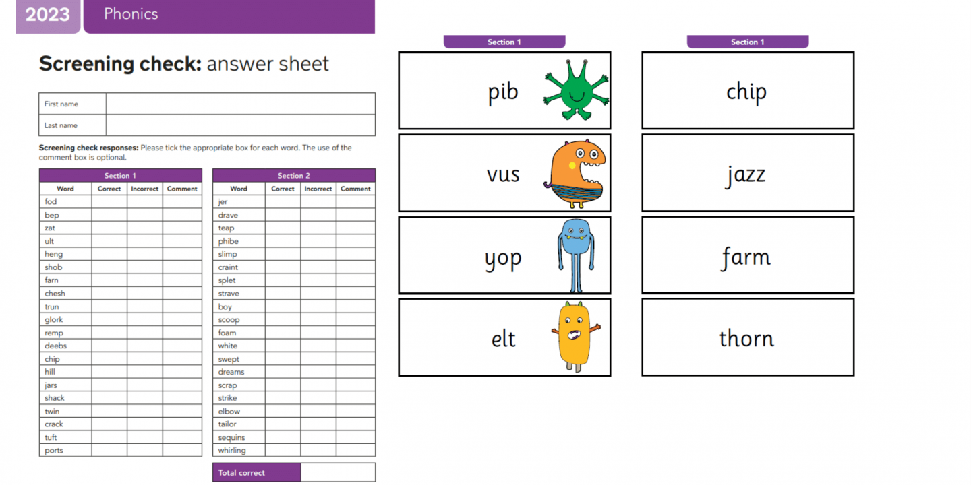
What is The Phonics Screening check?
Phonics screening check June 2026
National test for all Year 1 children to assess their ability
to decode / read words.
All children are given 40 words to read, 20 real words and
20 pseudo-words (alien words)

Slide 9

How can I help my child?
1 . Read daily:
– Your child reads to you.
We ask for a minimum of 4 reads a week – record it in their
reading record.
- To your child.
Benefits to both – but they do different jobs and are not
the same thing.
2. Homework – particularly the phonics, please repeat any
activities throughout the week and beyond.
3. Phonics practise sheets – repeat these activities.

Slide 10
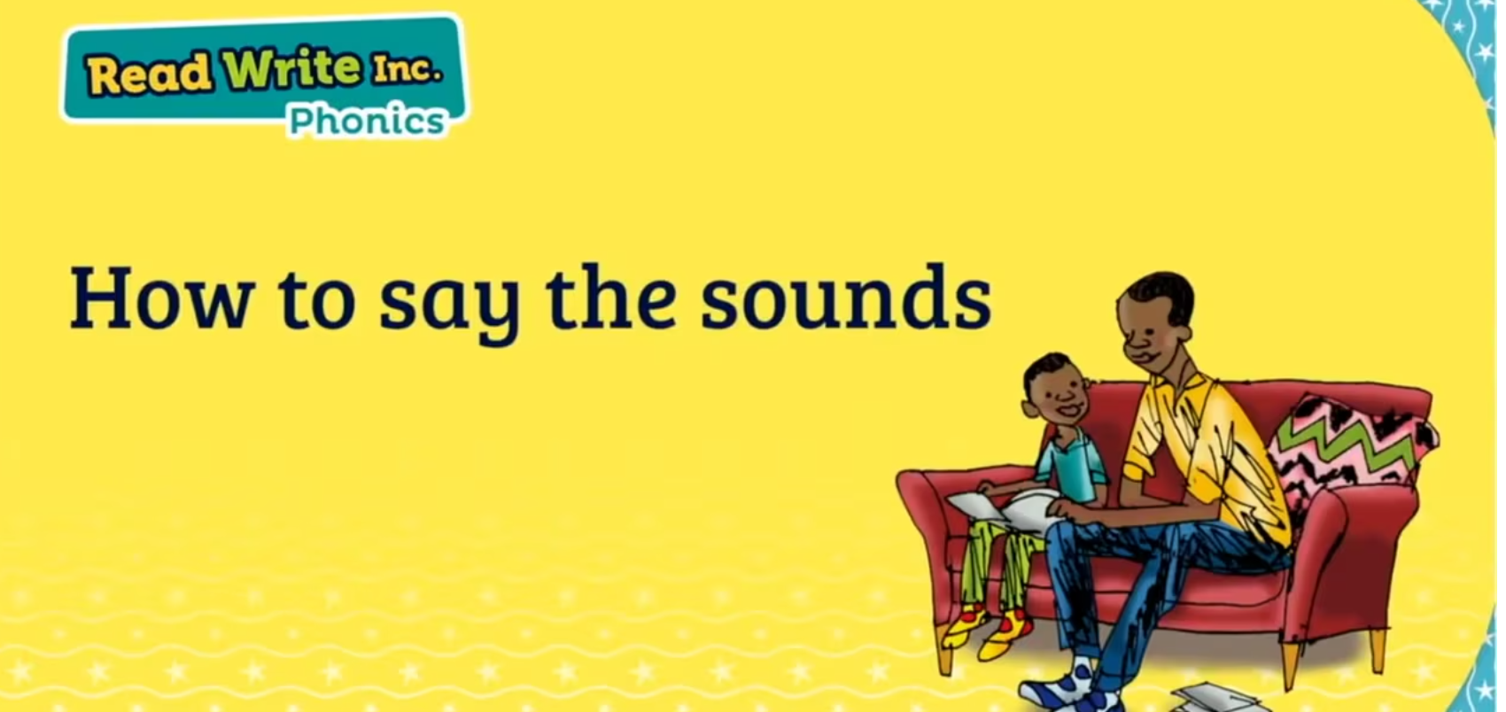
How can I help my child?
4. Model phonemes correctly – saying sounds correctly.
https://schools.ruthmiskin.com/training/search-resources/?search_term=How+to+say+the+sounds
5. Do come and ask us if you’re unsure of something!

Slide 11
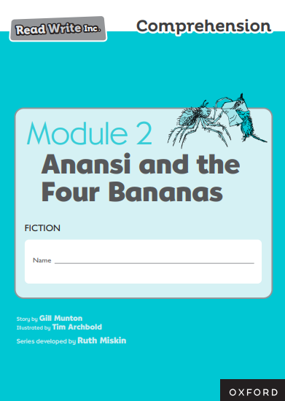
Year 2
Comprehension
Comprehension is a 20-week programme that prepares children for the higher expectations of the Year 2 literacy curriculum.
Comprehension uses the same approach to Read, Write, Inc to develop children’s reading fluency, comprehension and vocabulary.
The modules include fiction and non-fiction texts.

Slide 12
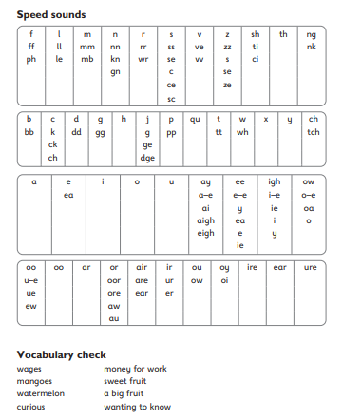
Year 2
Comprehension
There are 14 modules that follow the same systematic approach to learning.
Each session begins with revisiting speed sounds and a vocabulary check.

Slide 13
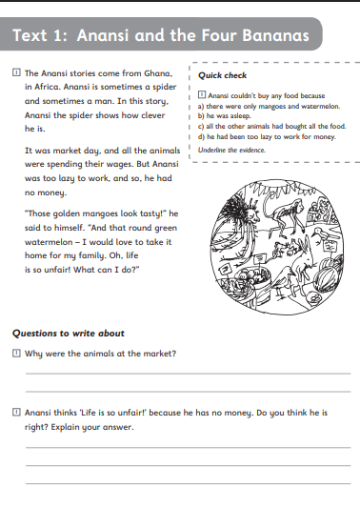
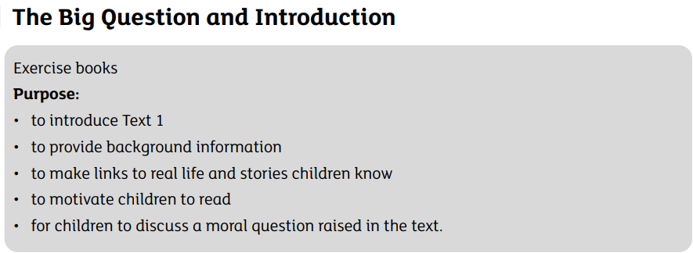
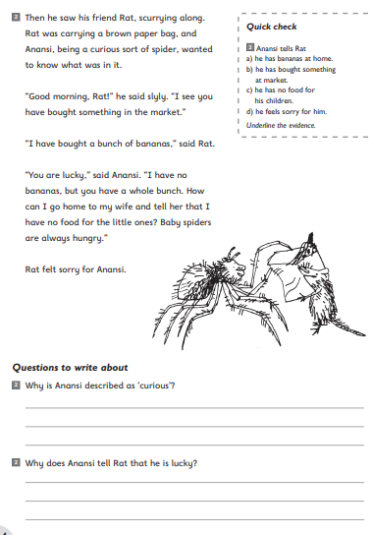
Year 2
Comprehension
The children are then asked ‘The Big Question’. This question sets the context for the text.
It encourages children to connect their own experiences to the forthcoming text and prepares them for the writing task.
Before reading the text, the children learn the key vocabulary which allows them to learn what the potential unfamiliar words mean in the text.
The children read in partners, and then the teacher reads aloud the text allowing the children to listen to the text being read out loud.
Children will work through the texts really focusing on their comprehension skills, underlining the answers, finding evidence, finding clues.

Slide 14

Year 2
Accelerated reader.
Once they have moved to comprehension they will begin Accelerated Reader.
They will take an initial quiz – star reading quiz
This generates a reading range – takes into account their fluency and comprehension
Children will then get a level with specific reading targets ( which they work on in school)
Children will choose a book from the library within their range (2.1-3.2)
Children will choose a book within this range.
After reading it they will take a quiz with the book next to them – applying skills taught in comprehension lesson.
End of term time they will take the star reading assessment – regenerates their reading range.

Slide 15

Any questions?

